Slide 1

AI-Powered Abusive Message Detection & Safe Content Classification
An intelligent platform leveraging NLP and Machine Learning to automatically detect, classify, and moderate harmful content across digital communication channels — in real time.
ACADEMIC RESEARCH PROJECT
AI · NLP · CONTENT MODERATION
NAME: PUSARLA SHYAMALA GOWRI DEVI
ROLL NO: 323129510045

Slide 2

The Digital Communication Crisis
The explosive growth of online platforms has created an unprecedented volume of user-generated content — much of it harmful.
📈 Scale
⚠️ Harm
Billions of messages sent daily across social media, messaging apps, and forums — far beyond human review capacity.
Hate speech, cyberbullying, threats, and toxic content spread rapidly, causing real-world psychological and social damage.
⏱️ Speed
Abusive content can go viral within minutes, outpacing any manual moderation response.

Slide 3

Why Manual Moderation Falls Short
Inconsistency
Human judgment varies by mood, context, and cultural background — leading to uneven enforcement.
Slow Processing
Manual review creates backlogs, leaving harmful content visible for hours or days.
Volume Overload
No human team can scale to match the millions of messages posted every minute.
Psychological Toll
Repeated exposure to graphic or hateful content causes burnout and mental health risks for moderators.

Slide 4

The AI-Powered Solution
Our platform combines Natural Language Processing, Machine Learning, and Deep Learning to automatically analyze, classify, and flag harmful content — accurately and at scale.
Text Input
NLP Preprocessing
ML Classification
Moderation Action
The system processes raw text through tokenization, vectorization, and semantic analysis before applying trained models to assign abuse categories and confidence scores in milliseconds.

Slide 5
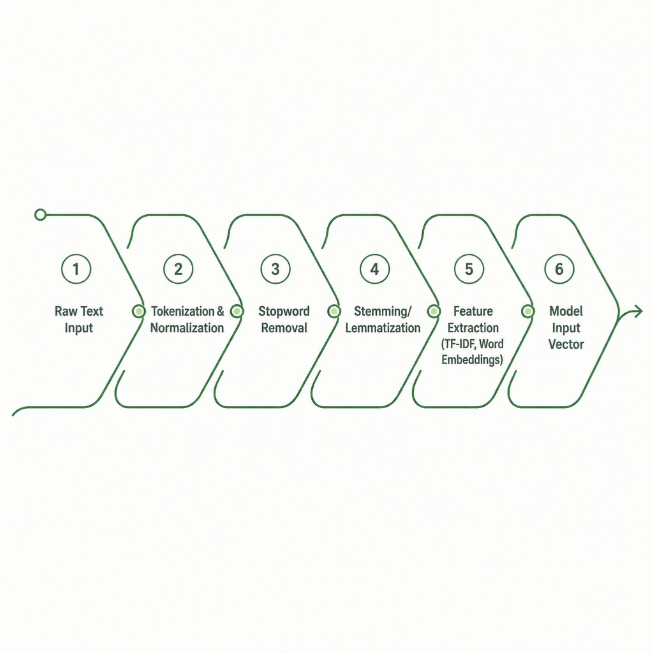
NLP Pipeline & Text Processing
Key Techniques
Tokenization: Splits text into analyzable units
TF-IDF & Word2Vec: Converts text to numerical features
Named Entity Recognition: Identifies targeted individuals or groups
Sentiment Analysis: Detects emotional tone and aggression
Context Windows: Captures multi-sentence abuse patterns

Slide 6
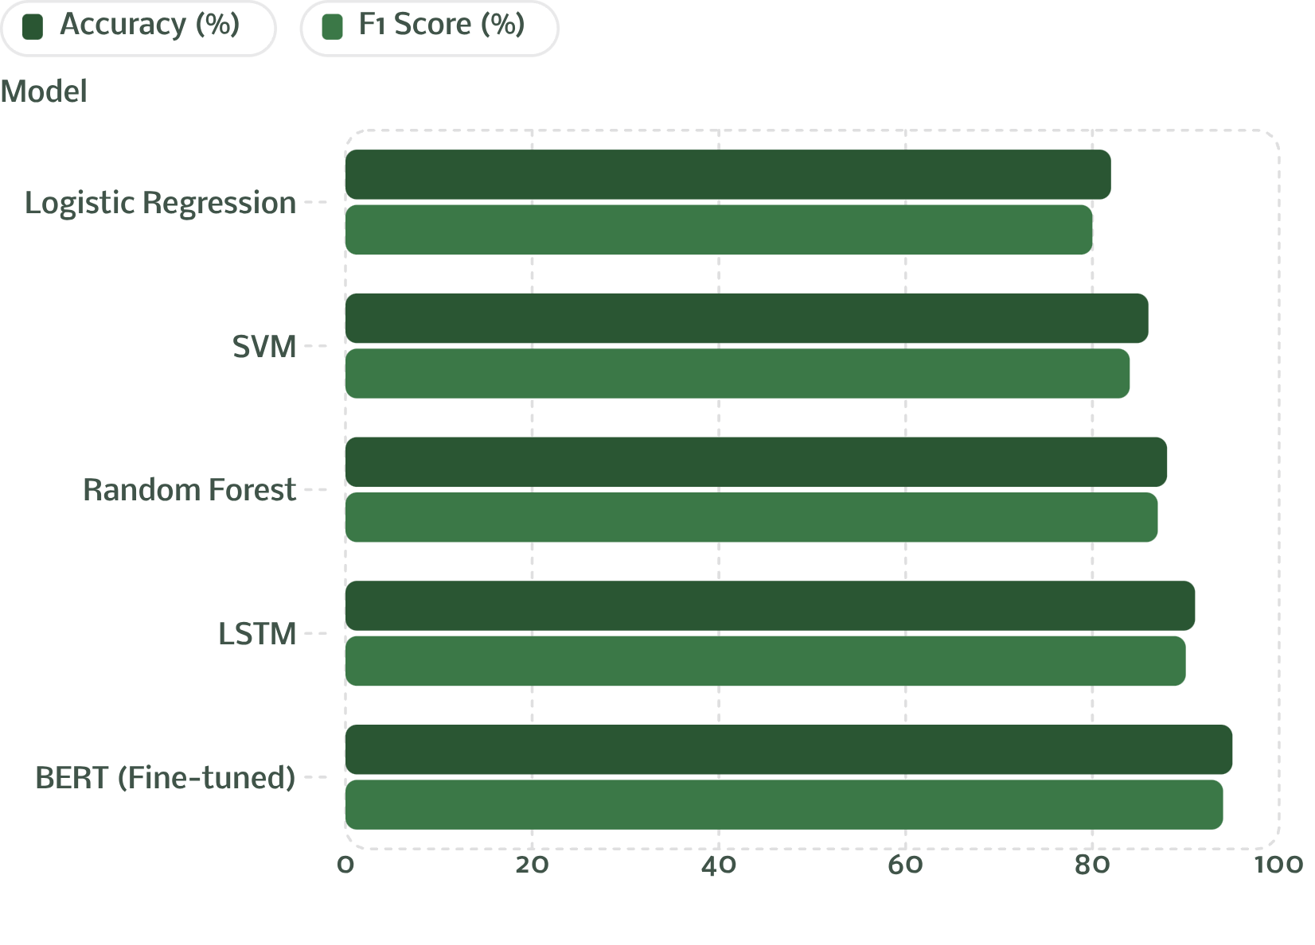
Machine Learning Models & Evaluation
Model Comparison
Deep learning models — particularly fine-tuned BERT — outperform traditional classifiers by capturing semantic nuance and contextual abuse patterns.
95% Accuracy
94% F1 Score
Best-performing BERT model
Balanced precision & recall

Slide 7
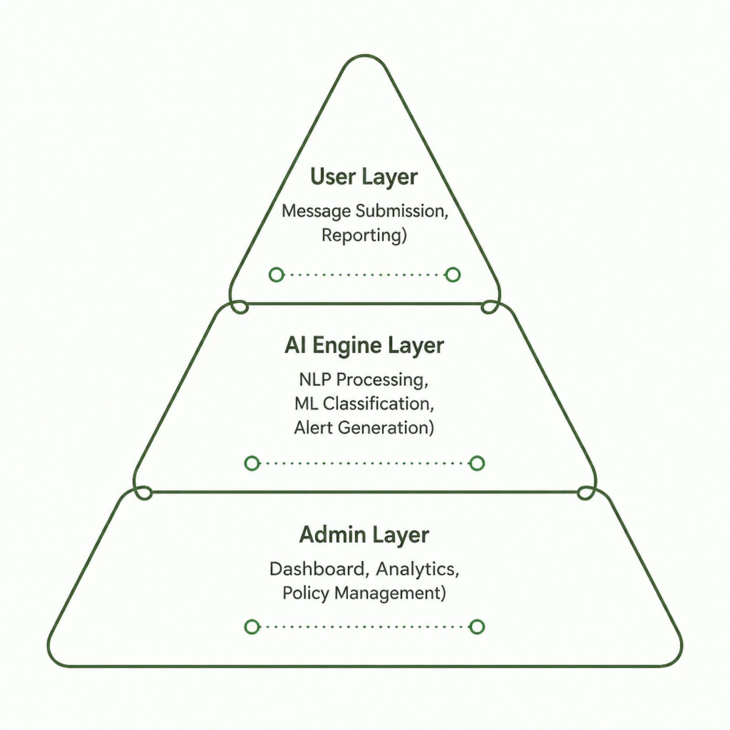
System Architecture & User Roles
Platform Roles
Users: Submit messages, report content, view moderation status
Moderators: Review flagged content, override AI decisions, manage queues
Administrators: Configure policies, access analytics, manage user roles
Core Modules
Real-time abuse detection engine
Automated alert & notification system
Moderation dashboard with audit trails
Report generation & compliance exports

Slide 8

Analytics Dashboard & Reporting
Real-Time Monitoring
Live feed of classified messages with abuse category breakdowns and confidence scores.
Automated Alerts
Instant notifications for high-severity content requiring immediate moderator attention.
Compliance Reports
Exportable reports covering moderation decisions, trends, and policy adherence metrics.
Threat Intelligence
Pattern detection identifies coordinated harassment campaigns and emerging abuse vectors.

Slide 9
Technologies, Security & Ethics
Implementation Stack
Ethical Considerations
Backend: Python, Flask/FastAPI, TensorFlow, PyTorch
NLP: Hugging Face Transformers, spaCy, NLTK
Database: PostgreSQL, Redis (caching)
Frontend: React.js, D3.js (visualizations)
Security: OAuth 2.0, JWT, AES-256 encryption
Bias Mitigation: Diverse training data and fairness audits
Transparency: Explainable AI (XAI) for flagged decisions
Privacy: GDPR-compliant data handling and anonymization
Human Oversight: Appeals process for disputed classifications

Slide 10

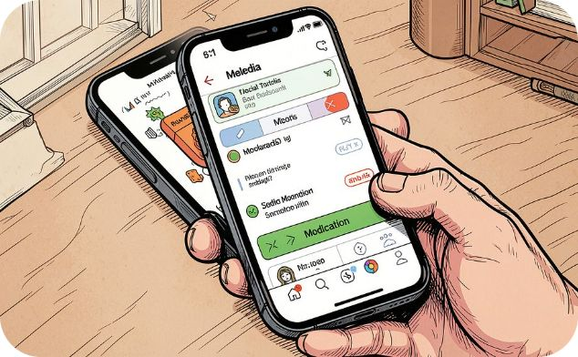


Applications, Outcomes & Future Roadmap
Education
Social Media
Enterprise
Protect students from cyberbullying in LMS platforms and school messaging systems.
Scale moderation for platforms handling millions of posts, comments, and DMs daily.
Maintain professional communication standards across internal chat and support systems.
Future Enhancements: Multimodal detection (images + text), multilingual support for 50+ languages, federated learning for privacy-preserving model updates, and integration with blockchain-based content provenance tracking.

